Slide 1
CS 401 – ARTIFICIAL INTELLIGENCE
LECTURE: INTELLIGENT AGENTS

Slide 2
TABLE DRIVEN AGENT
MOST IMPRACTICAL APPROACH
Table lookup for entire history to decide on action

Slide 3
Agent types
Four basic types in order of increasing generality:
Simple reflex agents
Model-based reflex agents
Goal-based agents
Utility-based agents

Slide 4
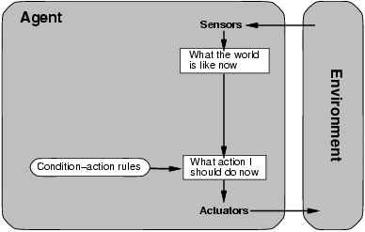
Simple reflex agents Select action on the basis of current percept, ignoring all past percepts

Slide 5
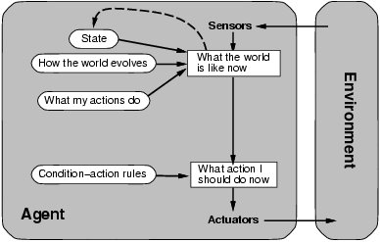
Model-based reflex agents Maintains internal state that keeps track of aspects of the environment that cannot be currently observed

Slide 6
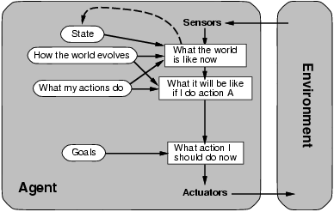
Goal-based agents The agent uses goal information to select between possible actions in the current state

Slide 7
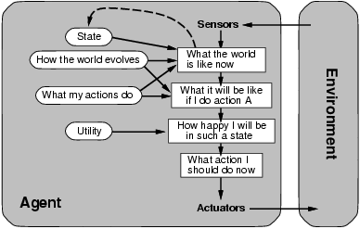
Utility-based agents The agent uses a utility function to evaluate the desirability of states that could result from each possible action

Slide 8
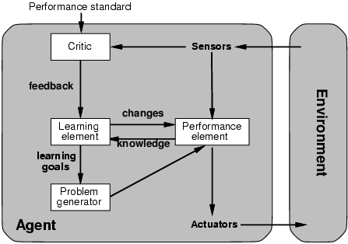
Learning agents

